Slide 1

From IT SERVICES
@
Featherstone High School
Network Manager: Harjinder Bhambra
MIS Manager: Ravi Singdia
Senior IT Technician: Inderjeet Sohal
Network helpdesk operator: Shama Yasin
Network / Laptop Technician: Amir Malik

Slide 2
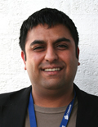

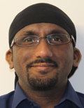
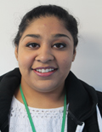
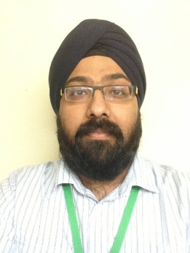
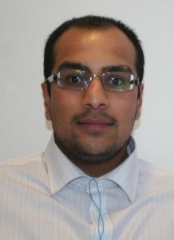
IT SERVICES
NETWORK MANAGER
Harjinder Bhambra
ASSISTANT NETWORK MANAGER
NETWORK HELPDESK OPERATOR
Ravi Singdia
Shama Yasin
SENIOR IT TECHNICIAN
NETWORK / LAPTOP TECHNICIAN
Inderjeet Sohal
Amir Malik

Slide 3

Quote from Audit 2013
“.. There has clearly been a significant and sustained commitment to ICT and this is demonstrated by the fact throughout the tour of the school just about every lesson observed had an element of technology.”

Slide 4
Introduction
In the next 30 minutes we will be looking at:
IT Computers and Software available throughout the school. Internally and externally available.
Introduction to key systems.

Slide 5
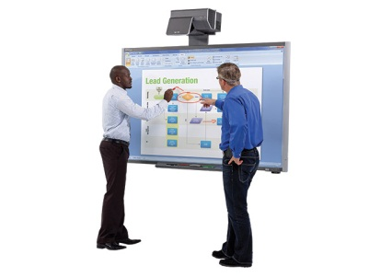
COMPUTERS WE PROVIDE 1/3
MAIN SCHOOL & B BLOCK
IWB PCs in every Classroom:-
Computer Workstations:
  Main School: LRC, B15, B16, Library, G1, G2 & SID.
  6th Form Library: 1.06, 1.07, 2.04, 2.05,
  IT POD 1&2 and Library
25 Laptop Trolleys in Classrooms:
  B Block: B1, B2, B4, B6, B8, B10, B12 & B14
  Main Building: F1, F2, F3, F4, F9, F10, F11, G1, G2 S1, S2, S4, S5, S6, S7, S8, S9
  and 2 Trolleys for Science.

Slide 6
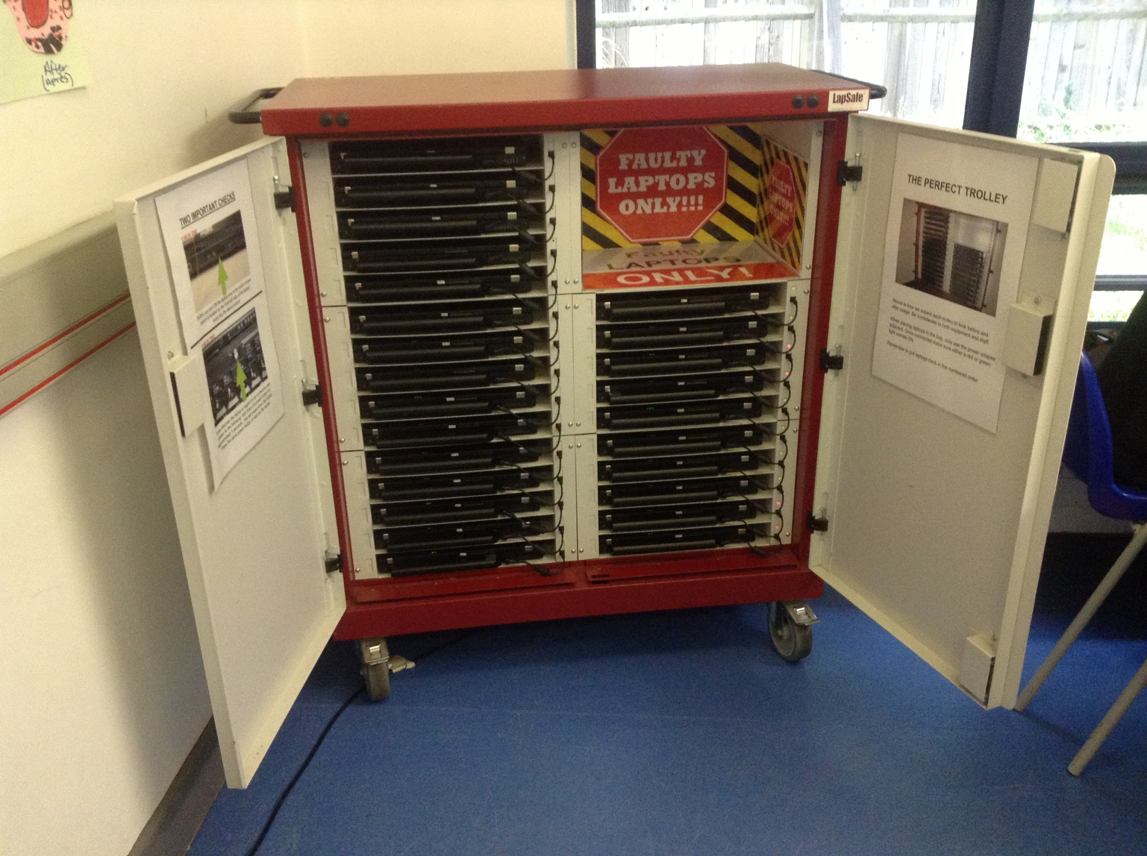

Slide 7
COMPUTERS WE PROVIDE 2/2
2 Mac Suites with 25 computers:
  Main Building A8
  6th Form Building Ground Floor Music AV Room
3 Class sets of 26 iPads
Sixth Form Personal Notebook
LRC 88 Computers

Slide 8
COMPUTERS WE PROVIDE 3/3
6th FORM BUDILING
Computer Workstations:
LOCATION | ROOM | No. Computers
Ground Floor | Library PCs MAC Suite | 20 25
First Floor | IT POD1 1.06 1.07 | 16 14 14
Second Floor | IT POD2 2.04 2.05 | 15 13 14

Slide 9
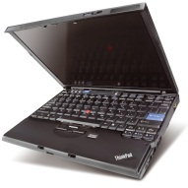
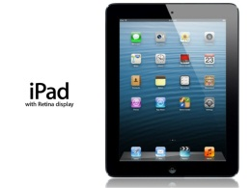
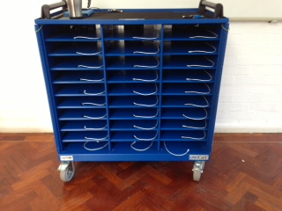
Staff devices
Staff PCs
  TLR Offices
  Permanent Teaching Staff have a..
    Laptop/Tablet Plus + iPAD4
    Inc – contract options and procedure
      Onsite and Offsite Contracts available
Staff iPad Charging Trolley

Slide 10
MAIN SOFTWARE ON NETWORK 3/3
ALL REMOTE ACCESS IS SINGLE SIGN ON
Remote Access
  Groupwise Email
  Shared Drives
  Support Ticket System (Kayako)
  MyBigCampus
  Google Services (Docs & Drive)
  Home Folder (Novell Filr)
  Password Self Service
  RoomBookingSystem

Slide 11
Staff iPads and Laptops
Laptop/iPad Chargers kept Safe
Any iPad Apps requested via Ticket System
Any damage to Laptop/iPad must be reported to IT Services as soon as possible.
iPad to remain in the case provided
No stickers/labels to be put on laptop/iPad.

Slide 12
SUPPORT TICKET SYSTEM
Support Ticket System has been launched to report issues, requests and projector bookings for IT SERVICES & FACILITIES.
This Support ticket system website will allow you to:
View all tickets created by you (Including closed ones) within and outside of school
Replying back to ticket emails will automatically update your support ticket.
Chat online for a quick resolve
View a Knowledge base with Help guides, telephone lists etc...
See the Latest News from IT Services / Facilities
View all the notes on your ticket and add extra notes
Add Attachment to the Ticket
Booking Projector

Slide 13
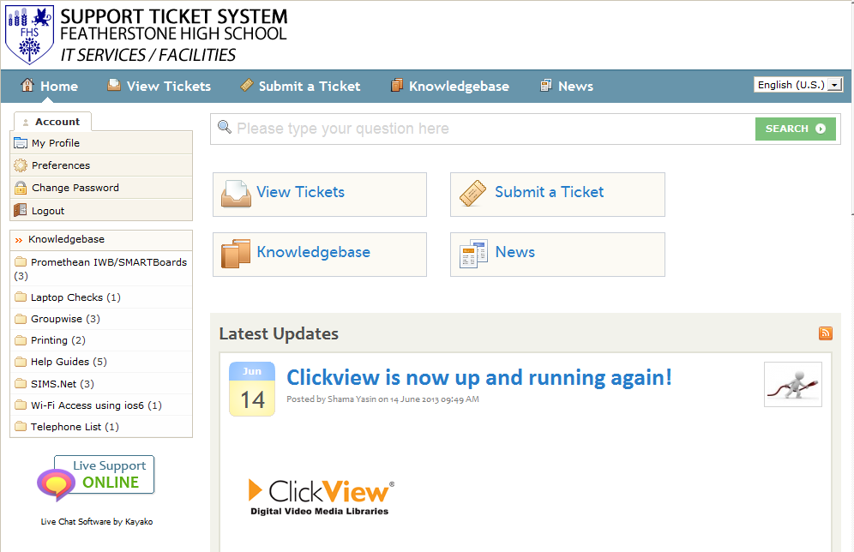

Slide 14
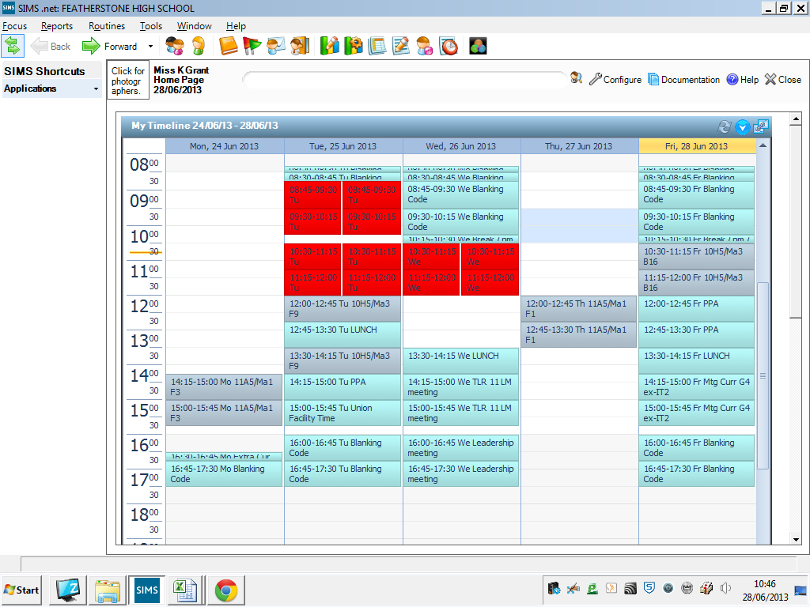

Slide 15
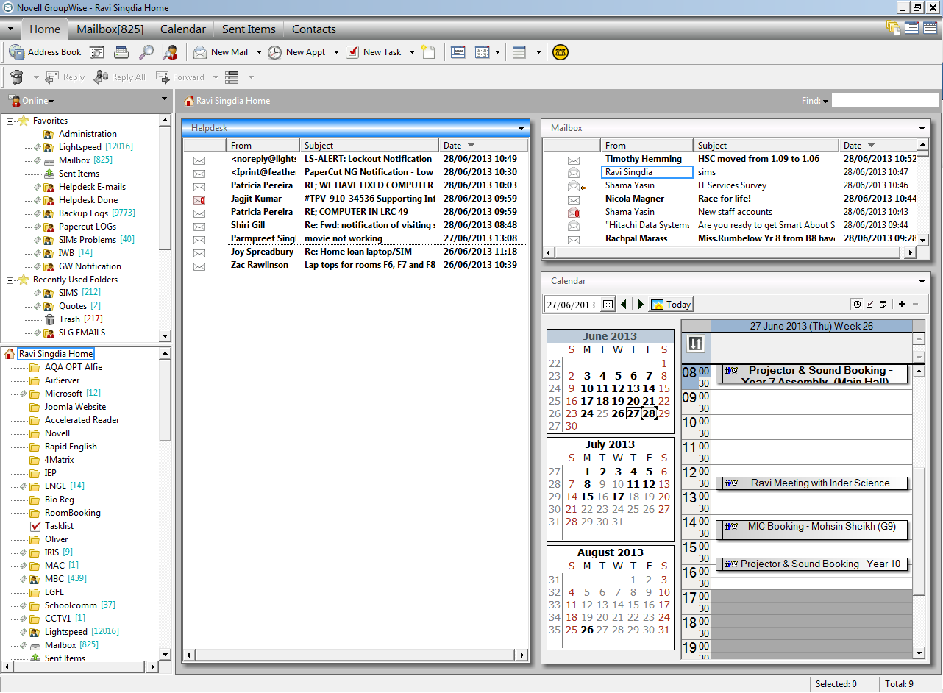

Slide 16
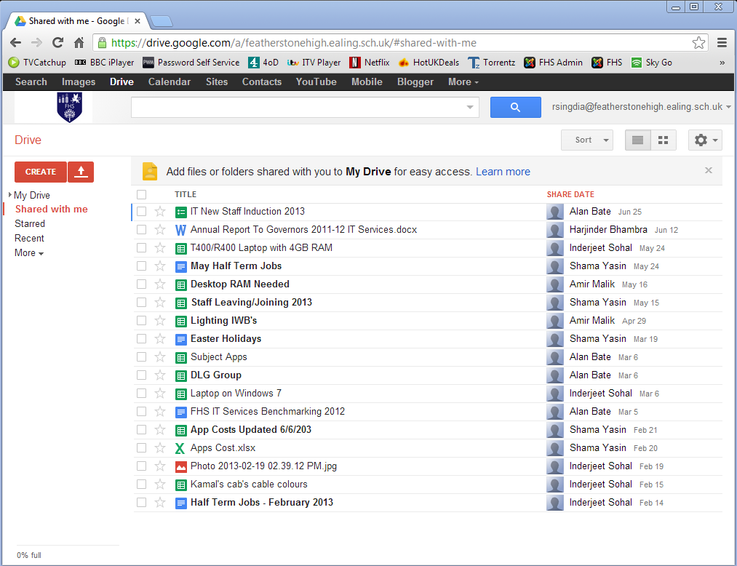

Slide 17
And Finally
be aware of social media websites…
Further reading has been emailed to you from Shama.
Survey Emailed to you.
Notes:
Guidance for school staff regarding social networking sites
Many of you will belong to a social networking site (eg Facebook, Twitter, My Space) and there are some important issues to note if you want to protect yourself.
Do not accept any contact with current or previous pupils
If under 18s are on your list (perhaps family members) be especially careful that the content is appropriate, including photos
Avoid bad language, sexual connotations, obscene jokes
Avoid criticism of your employer
Remember these sites are not always private - often there is a wide access. Ensure that your privacy settings are set to private. Do not say anything that you would not say in public. This is especially important as there have been cases across the country where people have been found to be showing "poor judgment" in relation to professional conduct and/or safeguarding which may be recorded on their permanent record which could affect references.

